Slide 1
MAXduino R1.2 Design Walkthrough
Note: In some cases photos of a previous revision are used where there is no material difference to the main message.

Slide 2
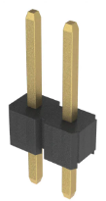
MaxDuino Block Diagram
DC In (9-15VDC)
AC In (9-16VAC)
DCC In (9-16VAC)
Power Supply
Filtered DC
5 VDC in or out
Regulated 5 VDC
Vin_En
5 VDC
Arduino NANO
Vin
5 VDC
D10
D11
D12
5 VDC
Speaker Terminals
MP3 Module
D3
DCC Opto-Isolator
DCC Injection
5 VDC
D0
D1
D2
5 VDC
Two Sets
Terminals
RS-485
D4
NeoPixel
5 VDC
5 VDC
NPX_BYP
EOL_En
A4
A5
I2C Header
I/O Header Pins
D4, D5, D6, D7
D8, D9, D13
A0,A1,A2,A3
A4,A5,A6,A7
Only Aref and Reset pins are not used

Slide 3
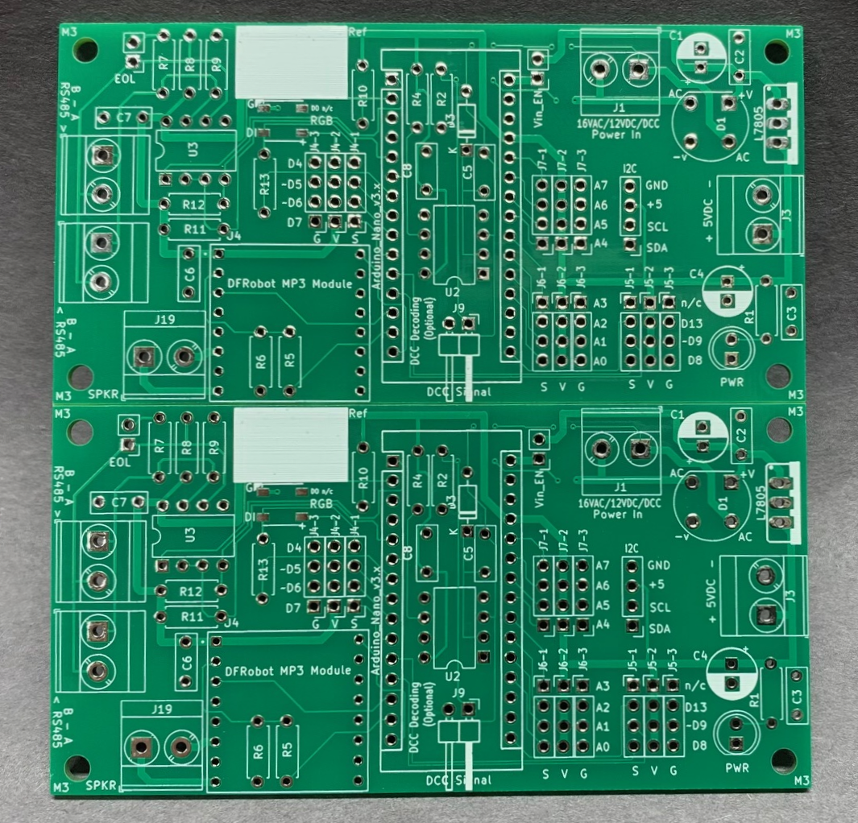
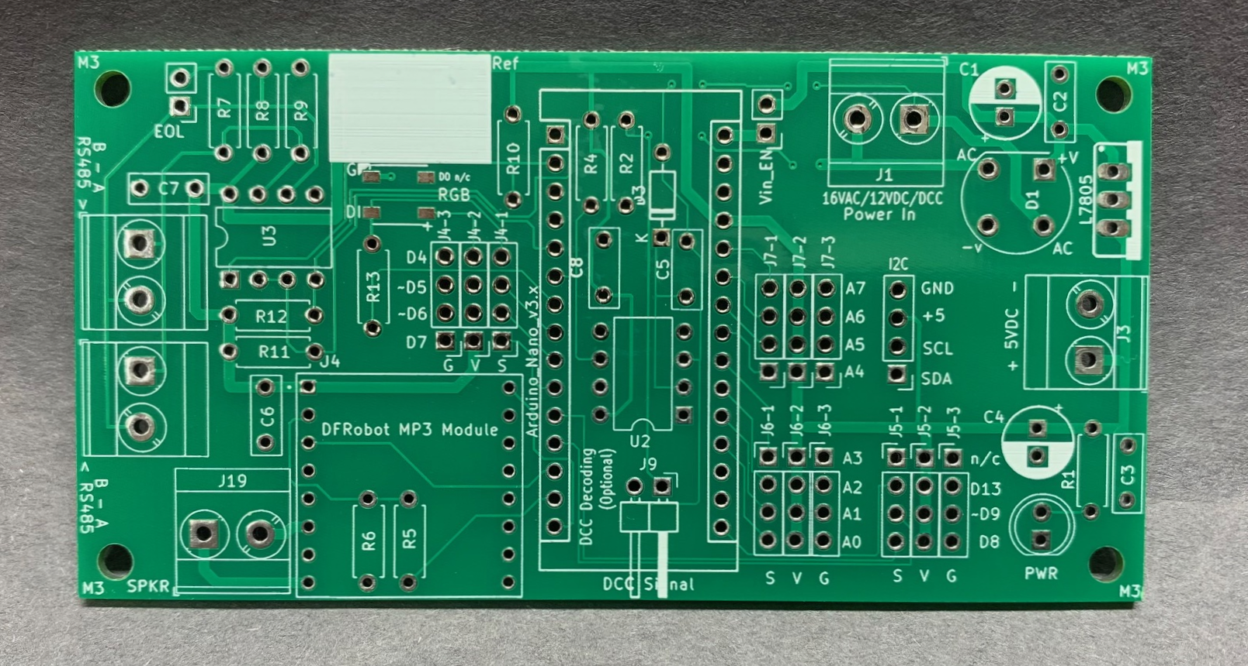
MaxDuino PCB (General arrangement)
One MaxDuino.
Vee cuts in the PCB allow clean separation with minimal force.
Two panels on one PCB under 100mm x 100mm

Slide 4
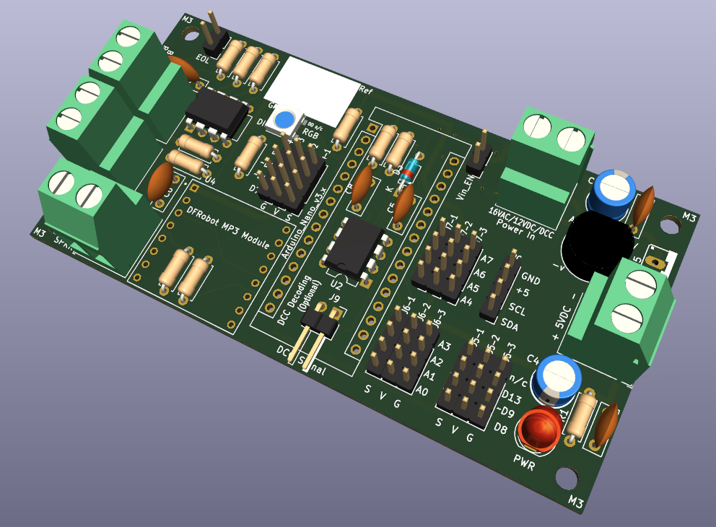
MAXduino
WS2812B
RGB Neopixel
Opto-Isolated DCC Decoding
Under Arduino Nano
16 VAC input or 12 VDC input or
DCC Input
RS485 and Terminals
Versatile Power Supply
I2C
5 VDC input (or output)
Speaker Terminals
MP3 Player
I/O 3 pin headers in groups of 4
Power LED

Slide 5
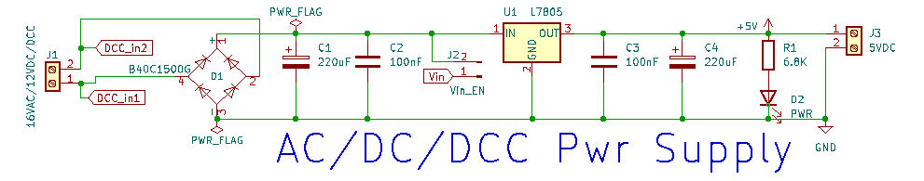
Design Review - Power Supply
Power comes in from the left. Up to 16VAC, 12VDC, or a DCC feed. It then goes through full wave bridge rectifier D1 and filter capacitors C1 and C2. This filtered DC voltage is now the input to the 5 volt regulator chip L7805.
The 5 volt regulator is capable of providing 1.5 amps and is internally protected against short circuits.
The 5 volt output is filtered with C3 and C4 to produce a rock steady 5 volt supply for significant projects.
A LED is used to indicate the presence of 5 volts (even without any Arduino present.)
On the right hand side is a second set of terminals which can be used as a 5 volt output to supply other circuits, or this can be used as a 5 volt input (in which case the L7805 regulator and everything to the left of it is not required.
On the left hand inputs, if DCC is used as the power source these signals are also routed to the DCC optoisolator circuit. Notes: The same voltage at the input to the voltage regulator chip can be routed to the Vin pin of the Arduino by inserting a jumper at J2. This is effectively puts the Arduinos own 5 volt regulator in parallel with the L7805. (You must verify Vin is 12VDC or less otherwise the Arduinos on board regulator could be damaged).

Slide 6
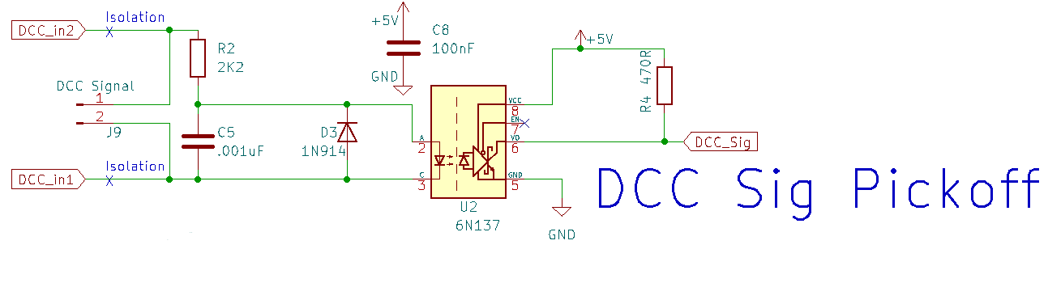
Design Review – DCC Decoder
The DCC signal from the power circuit comes in on the left as DCC_in1 and DCC_in2. These are routed through two isolation points (thin traces on the PCB that can be scratched open circuit if needed). The DCC signal goes onto the 2K2 current limiting resistor R2 and then through the optoisolator U2. D3 provides reverse polarity protection for the optoisolator diode. C5 (in conjunction with R2) provide transient noise rejection. The output of the optoisolator goes to Arduino an pin and is pulled high by R4. Pin 7 is not used (The optoisolator is always enabled)
Note: Those components should be amongst the first installed for access reasons as the Arduino header pins will restrict access after those are installed.
NOTES: If DCC is not used as the MAXduino power supply but you still want to decode dcc signals then the two DCC isolation traces must be made open circuit. These traces are clearly marked on the bottom of the MAXduino PCB.
Once these traces are opened then any power source can be used for the board and an independent DCC signal for decoding can be input via J9 which is a pair of horizontal pins located on the PCB under the Arduino.

Slide 7
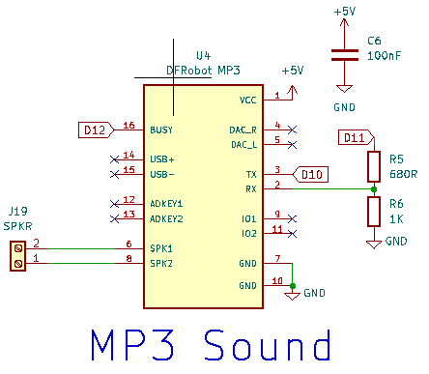
Design Review – MP3 Player
This circuit utilizes the common DFRobot MP3 player module. This module has an SD card reader and so it can play MP3’s located on a memory card. These can be sound effects, station announcements, or any other sounds as required.
Any small 8ohm speaker can be connected to the speaker terminals. To avoid speaker damage the speaker should be rated at 3 watts or more.
The Tx pin from the module connects to D10 on the Arduino while the Rx pin is connected to D11. The use of software serial is required to implement this but as the transmission speed is a relatively slow 9600 bps this is not an issue. A pair of resistors are used to lower the voltage received by this module as it can glitch if the receive voltage is even slightly over its 5 volt limit.
The busy pin is taken back to the Arduino on pin D12 to provide real time status information.
The following library has been tested #include <DFPlayerMini_Fast.h>
Note: The DFRobot MP3 player module is recommended. There is a similar module with part number MP3-TF-16P but it did not work well for me. Specifically It did not respond to some commands. (e.g.: setting volume)

Slide 8
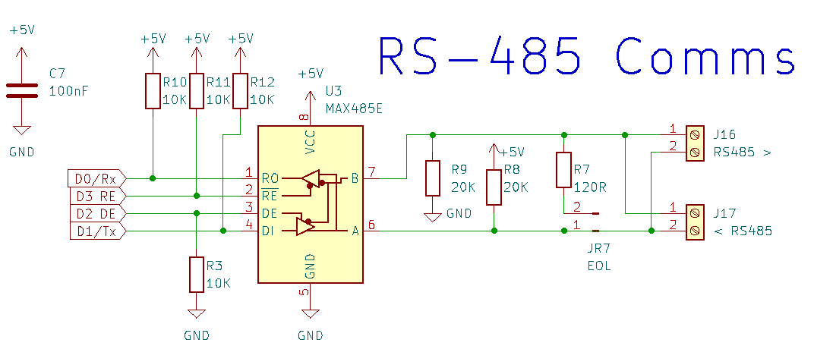
Design Review – RS-485 Communications
This circuit utilizes the common MAX485 chip to receive RS485 communications coming in from the right and convert them into standard logic level signals that the Arduino can read. There are two sets of terminals in parallel for the RS485 signals since this module is typically one ‘drop’ and the RS485 signals will daisy chain on. R7 is an EOL (End of Line) termination resistor. The jumper at JR7 should only be installed on one of the MAXduino boards and preferably the one farthest from the sending device (Typically a USB/RS485 interface). This chip interfaces with the Arduino Tx/Rx pins to take advantage of the Arduino UART. New with R1.2 now D2 and D3 sets the direction of transmission since RS485 is only half duplex (cannot transmit and receive at the same time). The use of pull up and pull down resistors means in circuit serial programming can work without disrupting other communications on the wires.
The following libraries were used in testing
#include <Auto485.h>
#include <CMRI.h>

Slide 9
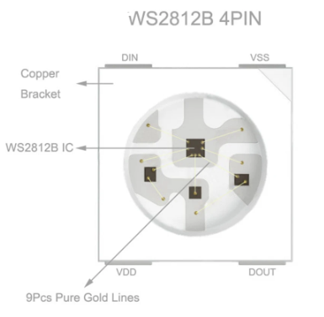
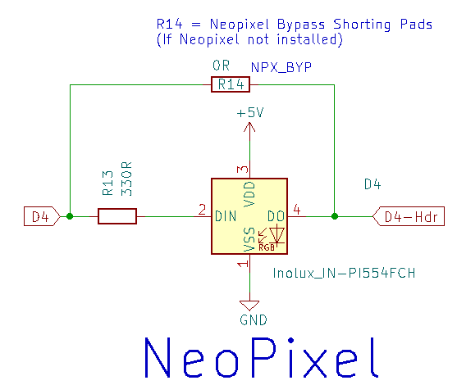
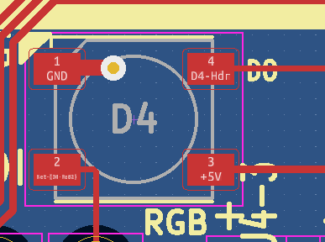
Design Review – NeoPixel
Ground pin denoted by white triangle
DO pin carries over to 3 pin header
A bypass if Neo
Pixel not installed.
Pinout for WS2812B NeoPixel chip.
Note Vss = Ground. VDD = + 5 volts
The shown orientation matches the PCB
DI pin from NANO pin D4 via 330R
This small circuit utilizes the common addressable LED WS2812B NeoPixel chip to provide a wide range of colour feedback options. The circuit utilizes one Arduino pin (D4) and has an on board 330 ohm (alternate=470) series resistor for the input pin. The three pin header with D4 is also available and suitable for longer strings of NeoPixel addressable LED’s. Be sure to consider power requirements when using long (more than 30 elements) strings of NeoPixels. Note a bypass set of pads exist and can shorted if the NeoPixel is not installed. This connects D4 direct to header pin.
The following library was used in testing
#include <FastLED.h>

Slide 10
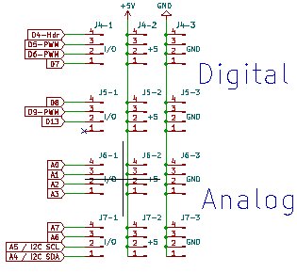
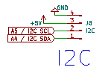
Design Review – Header Pins
The I2C header provides +5, Ground, SCL and SDA
In the same order as commonly found on OLED displays. Be sure to check the pin order for each device when using I2C. You may of course elect to install these as colour coded pins.
The I/O pins are arranged as four groups of four.
On the PCB this enables colour coded pins in strips of 4 to be used.
Each of the 15 I/O pins (one is not used) is presented as a 3 pin header.
The pin order is Signal, +5V, Ground … or S V G for short.
This pin order is a common but not universal (so always check your modules)
On the PCB some pins are marked with a tilde ( ~ ).
This is indicating these pins are PWM enabled.
Note A4/A5 pins are also part of the I2C header.

Slide 11
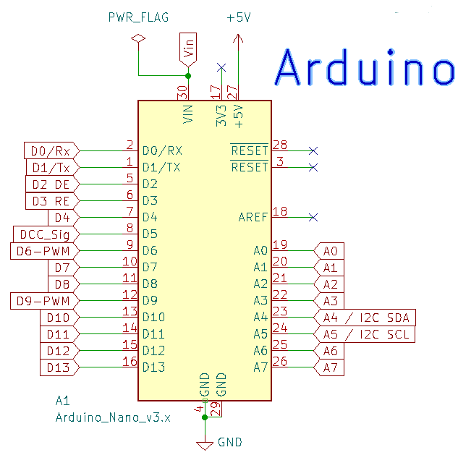
Design Review – Arduino
The Arduino NANO module is almost fully utilized as shown. Only 4 pins have no connections to them.
As of R1.2 both D2 and D3 are now used for RS485 direction control.
It is recommended to install female header pins on the PCB so that the NANO module can be simply plugged into those header pins. This also provides ample clearance for the DCC decoder circuit which is located under the Arduino.

Slide 12
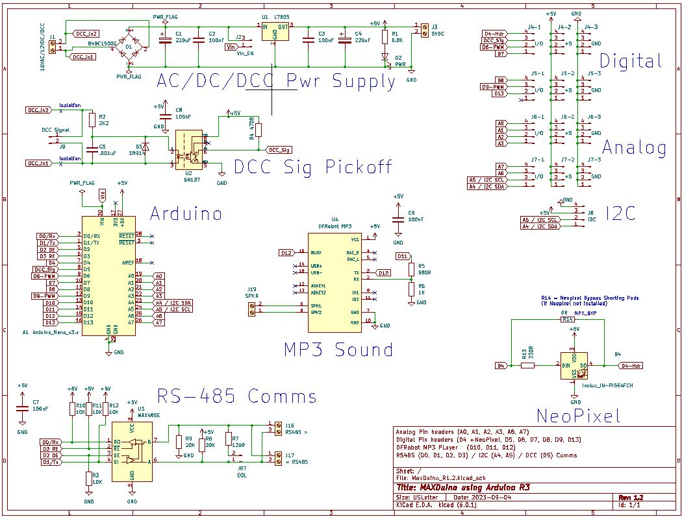
Design Review Full Schematic

Slide 13
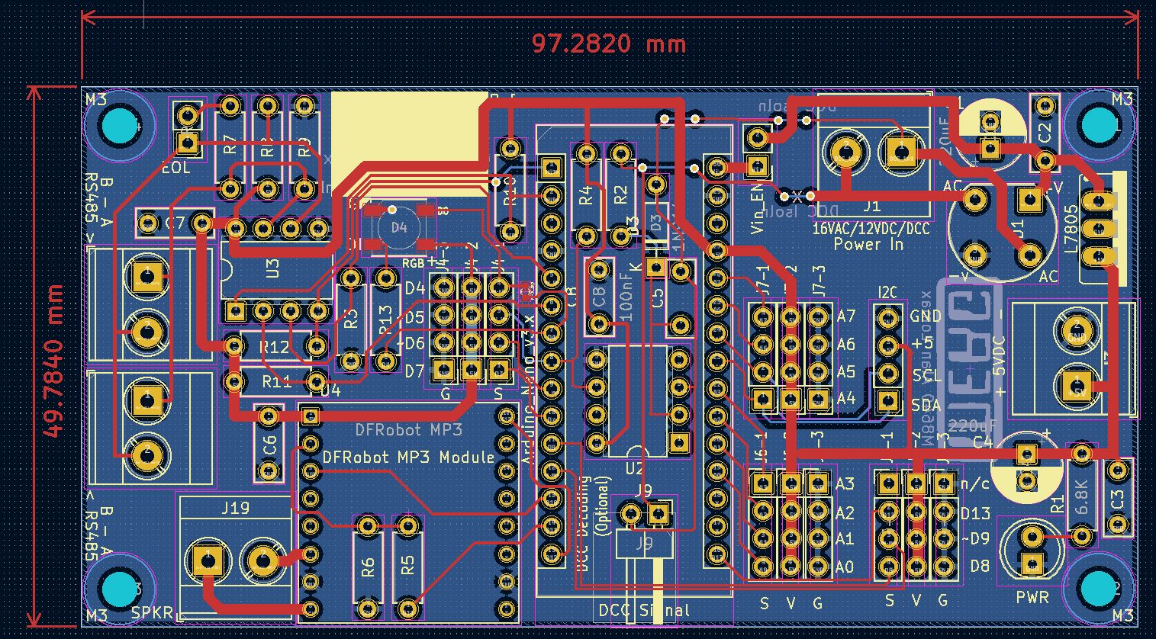
Design Review Full PCB

Slide 14
Management of Change
Rev 0 – Dec 2022 first 5 PCB’s (enough for 10 prototypes) ordered. Built up and tested several. Platform for developing test code.
Rev 1 – May 29 2023 second batch of 5 PCB’s ordered. Fixed DCC decoding, added 5 volt power input, added NeoPixel, changed 3 pin header and I2C header arrangement, Larger power traces, clarified stenciling. Rev 1 arrived June 12 2023: 3 of 5 boards (they contacted me about 2 that failed manufacturing) – credit note is on file but 3 is enough for testing. Found flaw in DCC Decoder section.
One PCB (Two MaxDuino) were given to Ian for evaluation.
Rev 1.1 Revised DCC Decoder circuit. Additional stencil near RGB NeoPixel to aid with orientation, additional stencil for double isolation of DCC signal pickoff from power supply section.
Ordered two batches of 5 PCB’s June 29 2023 from JLCPCB. All testing passed.
Rev 1.2 Revised RS485 circuit to use 2 pins for enabling direction control. This puts both into high impedance state when doing ICSP. Also added flow though on the on board NeoPixel and ability to bypass the NeoPixel if not needed.

